Slide 1
Krispy
Kreme
Rewards

Slide 2
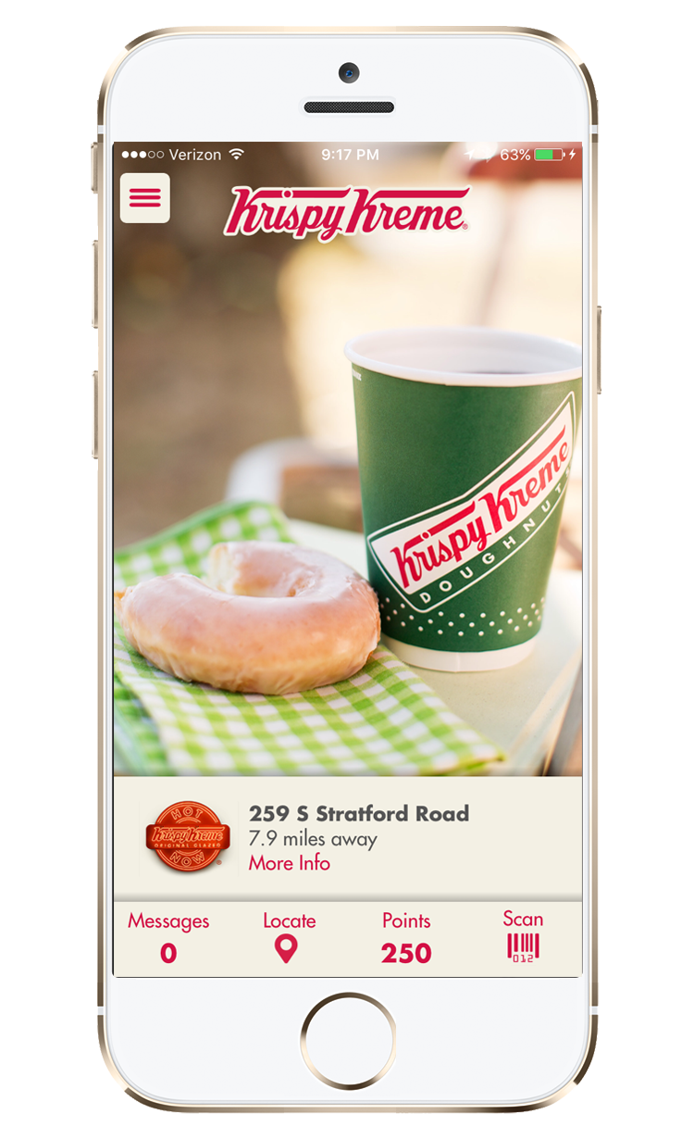
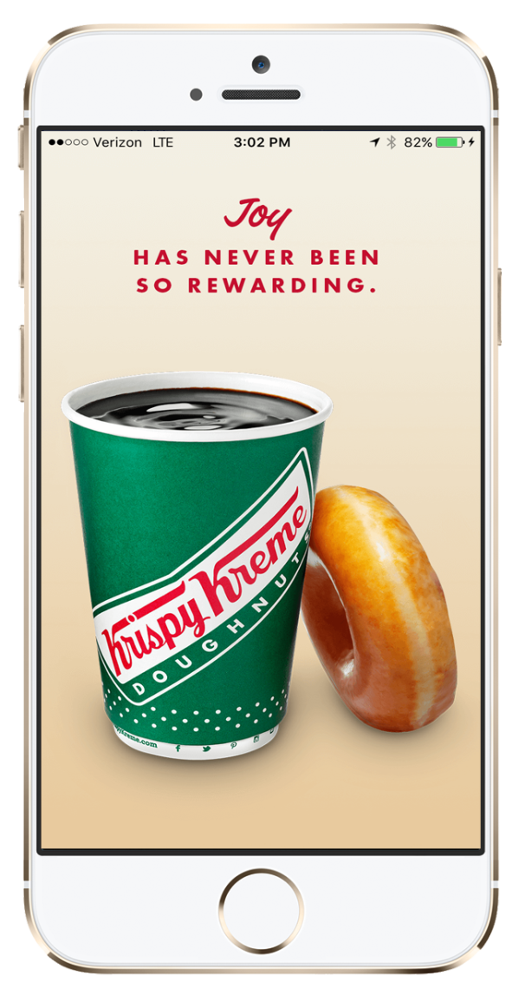
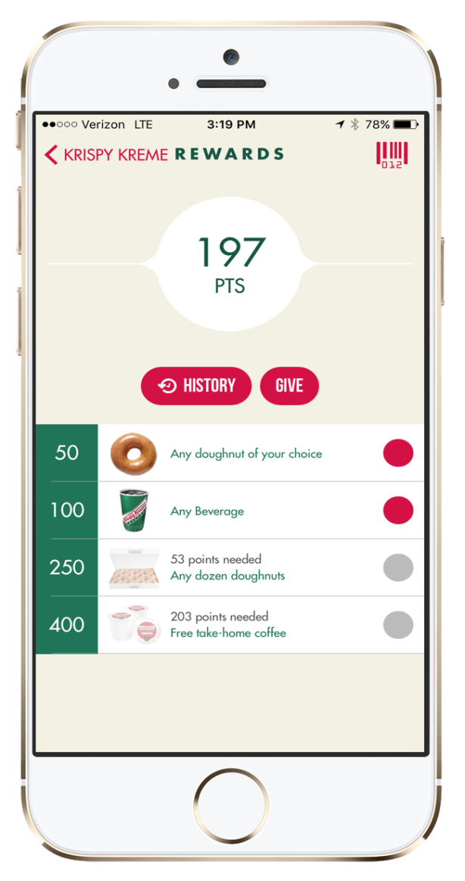
So, what is Krispy Kreme Rewards?

Slide 3
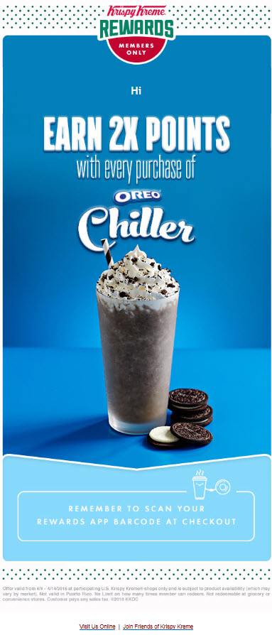
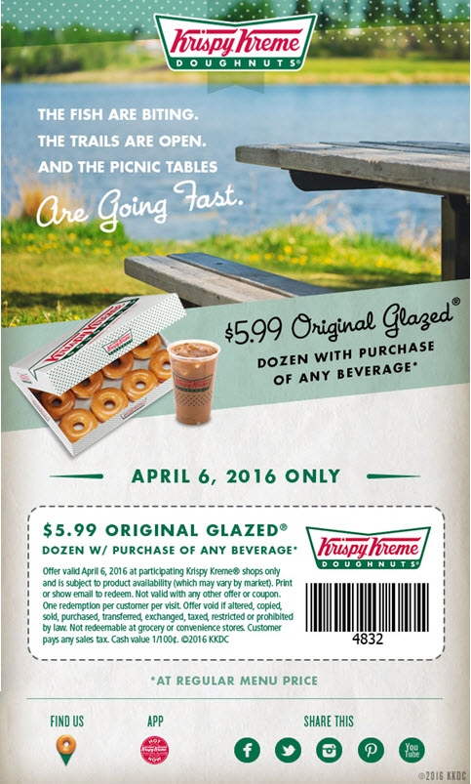
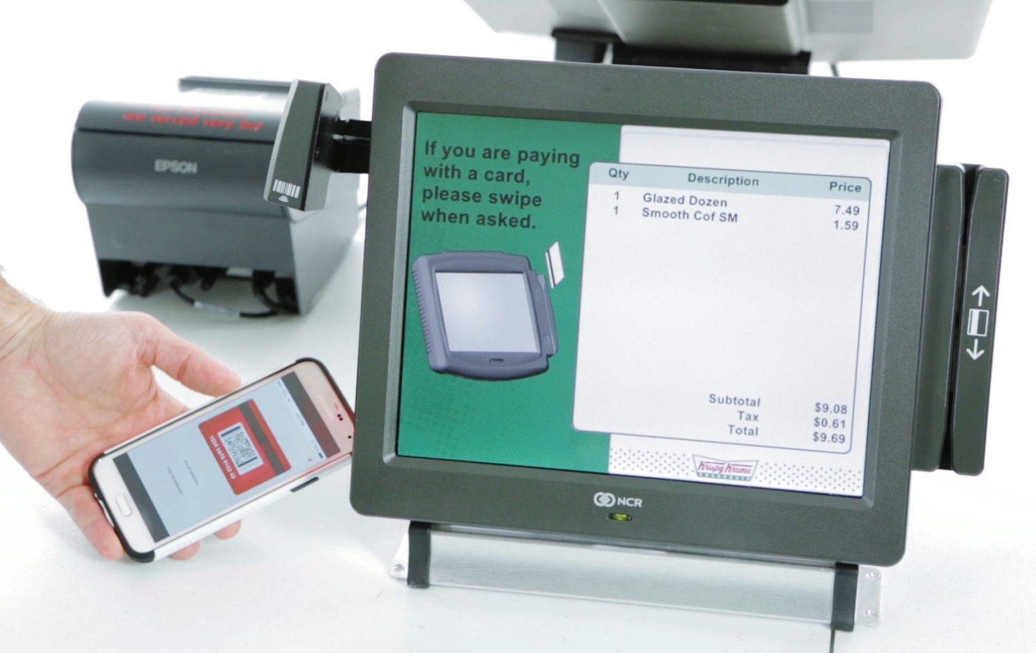
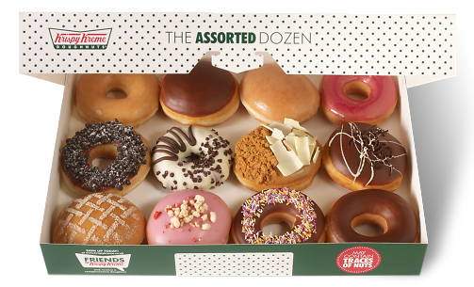
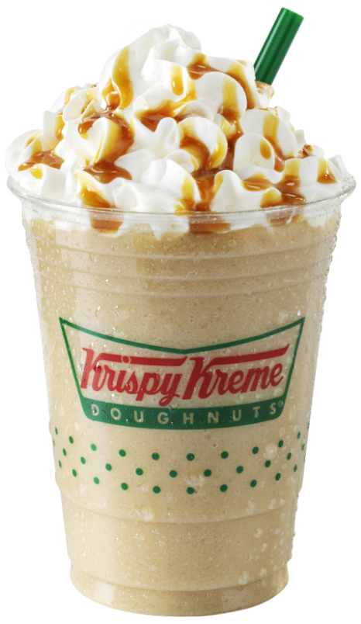
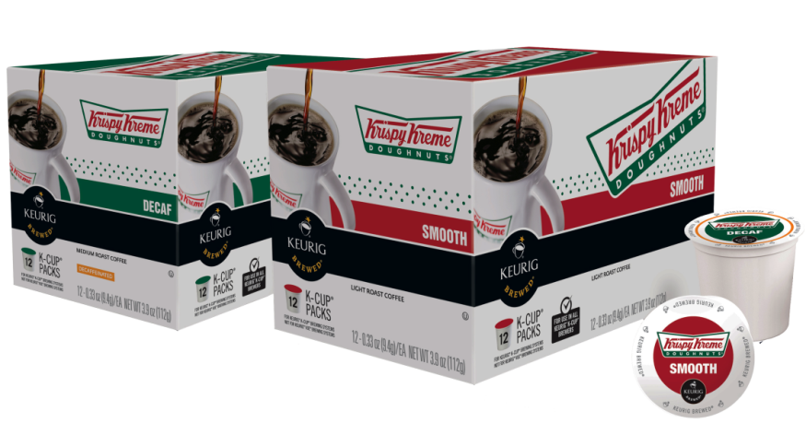
Members earn points for purchases
Members also become eligible for free items and special offers/opportunities
It is available via a mobile app

Slide 4
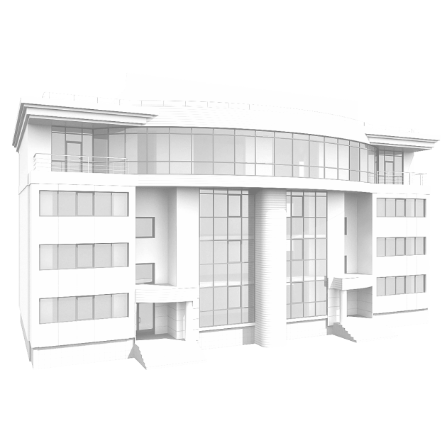
Why we created a Rewards Program…
6X
Notes:
6x more expensive to acquire new customer vs. retaining an existing customer
The average company loses between 10 and 30% of it’s customer base annually. These include the unfortunate death of a customer, the customer moves out of the area, but the biggest portion of this is from customer dissatisfaction.
7 out of 10 service providers cite customer retention and loyalty as critical growth factor.

Slide 5
Krispy Kreme Rewards Drives:
One more visit.
Purchase of a new item.
Sharing and inviting friends to participate.
Purchase of one more item.

Slide 6
Benefits of the Program
We are able to see and understand guest behavior
We are able to track and influence purchases and frequency
We customize programs based on behavior
More engaged guests = increased sales

Slide 7
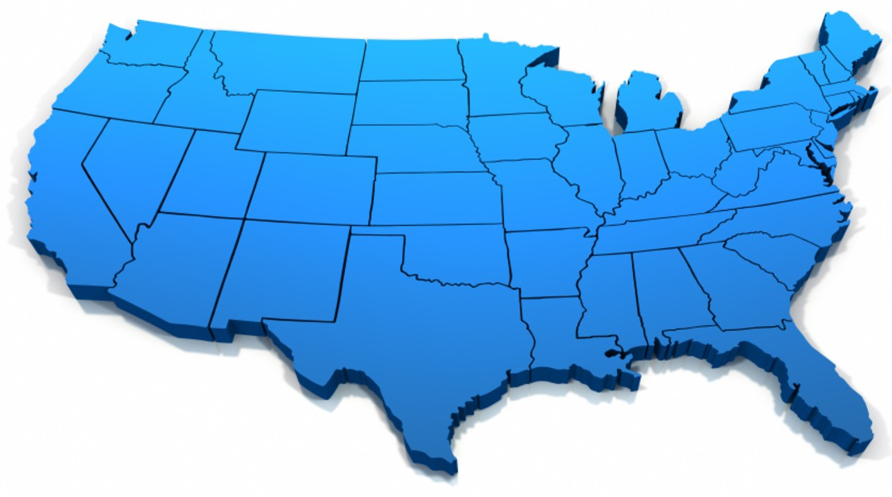
Program Kick-Off (Pilot)
Program launched December 4, 2014
18 shops in several different markets

Slide 8
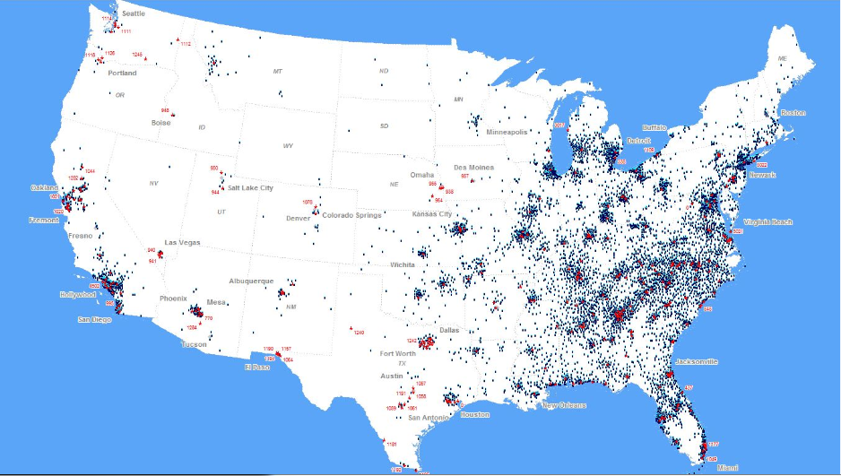
There are now over 500,000 members in the program with 35,000 signing up monthly.
Krispy Kreme Rewards is now available to anyone in the U.S.

Slide 9
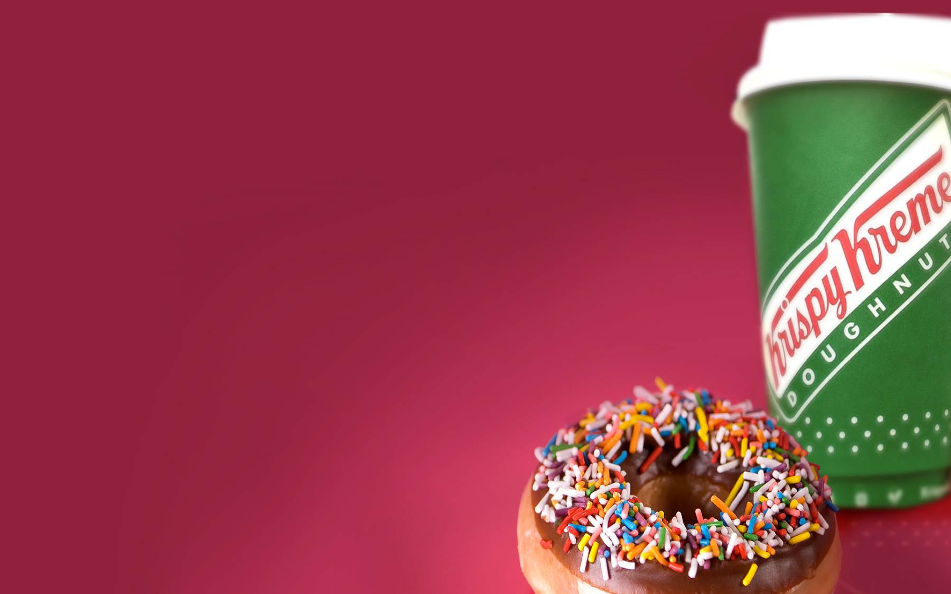
Part I:
Downloading the App and Joining the Krispy Kreme Rewards Program…

Slide 10
There are multiple ways to download the App:

Slide 11
Joining the Program

Slide 12
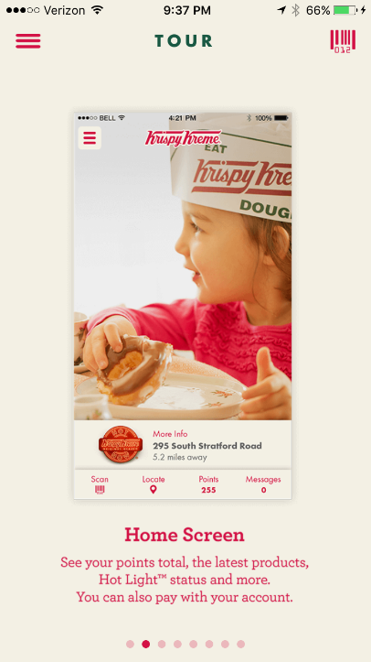
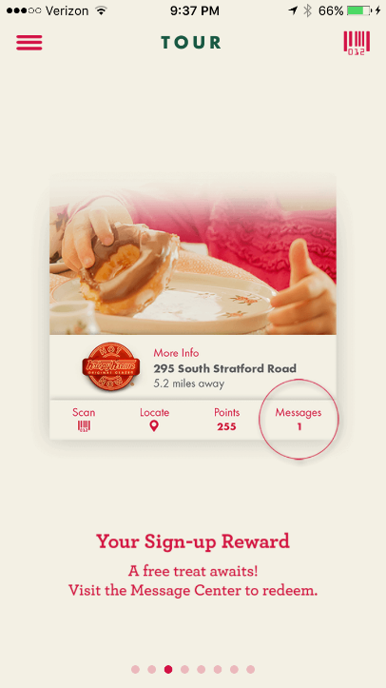
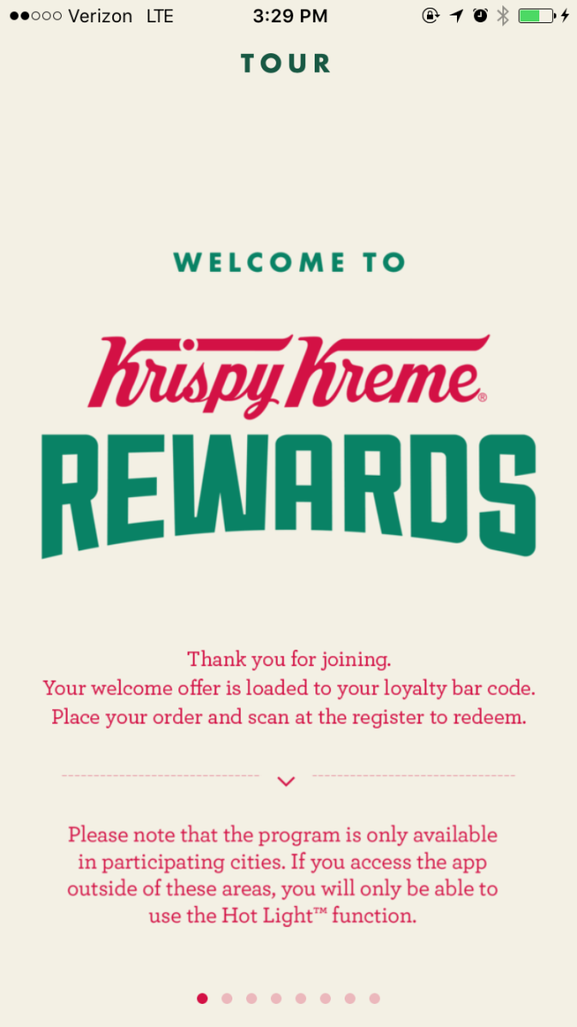
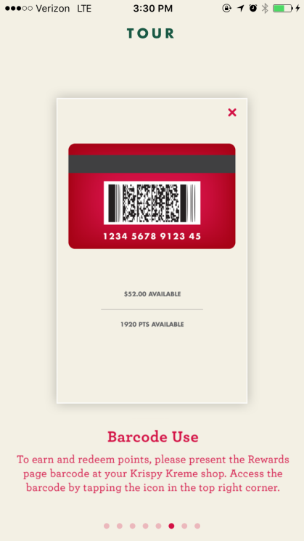
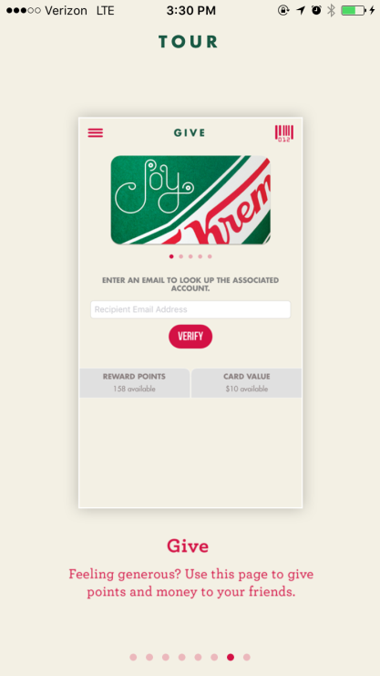
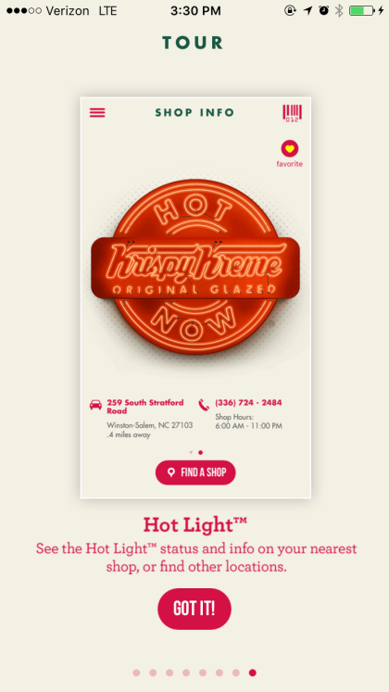
Joining
the Program
New members are taken through a brief tour of the main features the app provides.

Slide 13
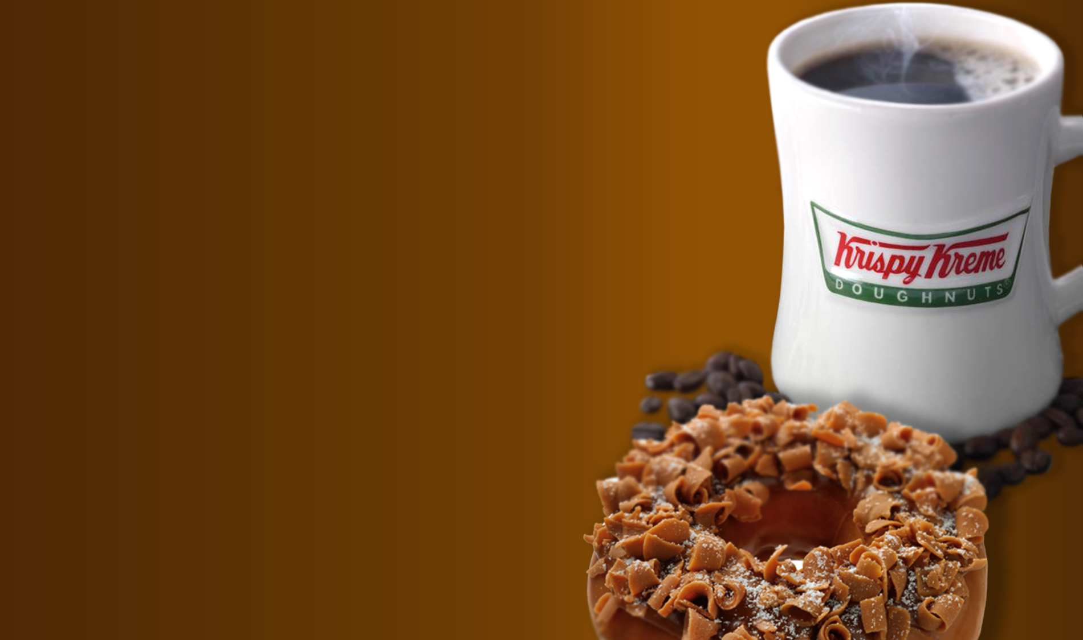
Part II:
Features and Main Page Icons

Slide 14
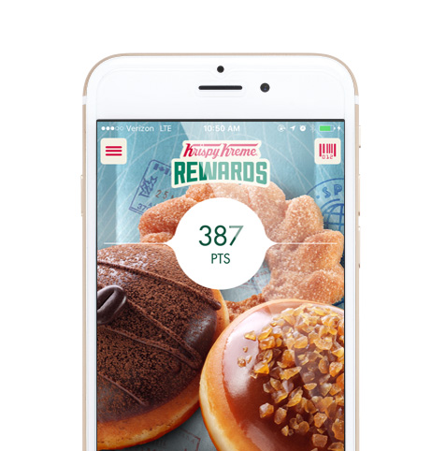
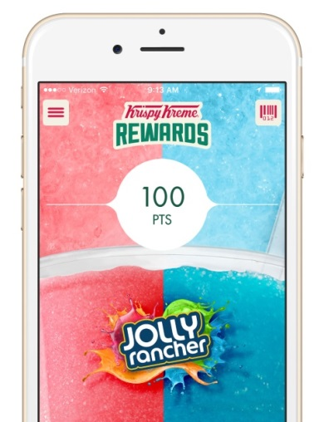
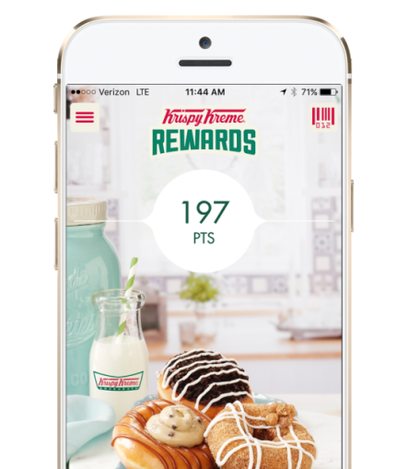
The
Main Page
Information hub for the app
Access everything that the app has to offer…
Aligned with Limited Time Offers

Slide 15
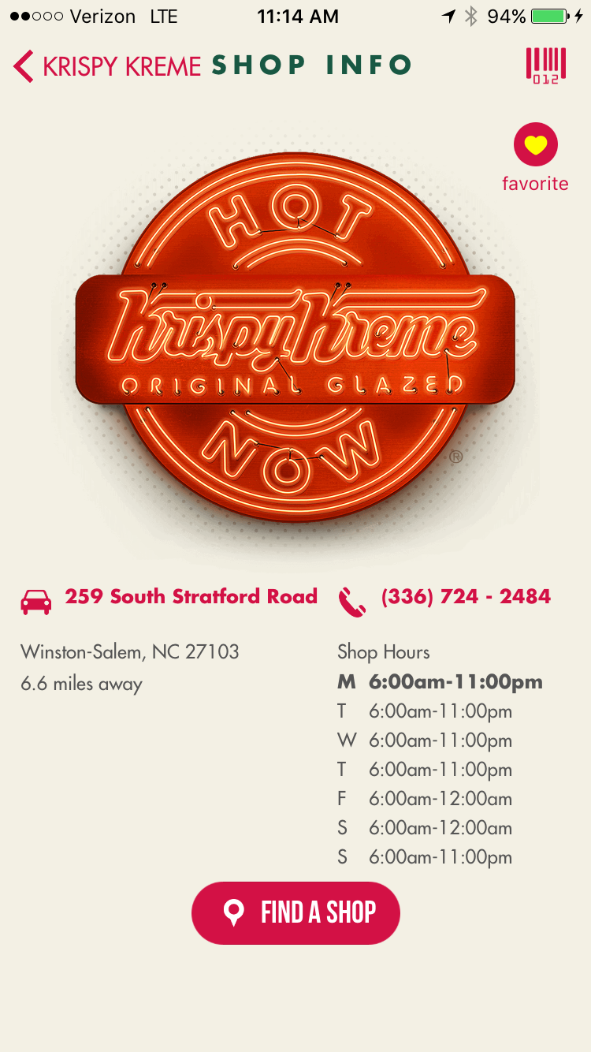
The Main Page:
Hot Light
The location nearest the member is shown, plus they have the ability to find another store
The Hot Light is illuminated during that store’s Hot Light hours

Slide 16
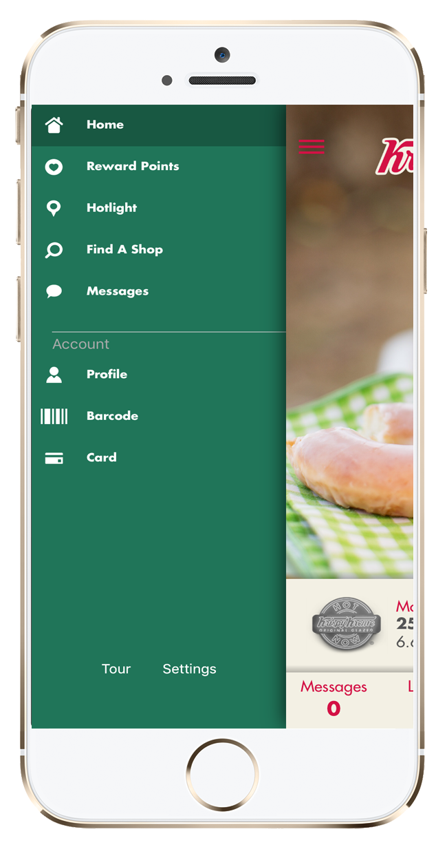
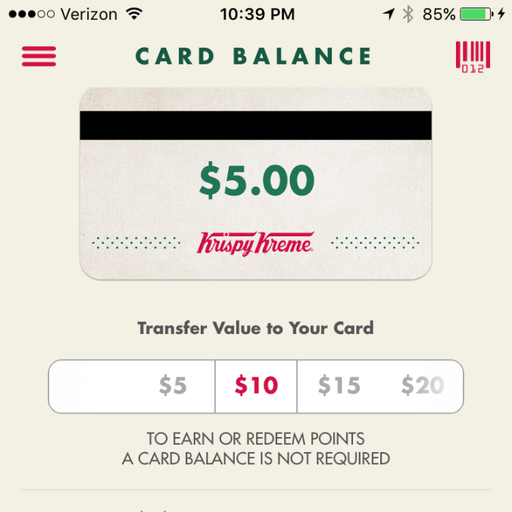
The Main Page:
Rewards Points
Stored value is accessed from the menu screen by clicking on the card button.
The member earns 5 points for every dollar spent
Stored Value

Slide 17
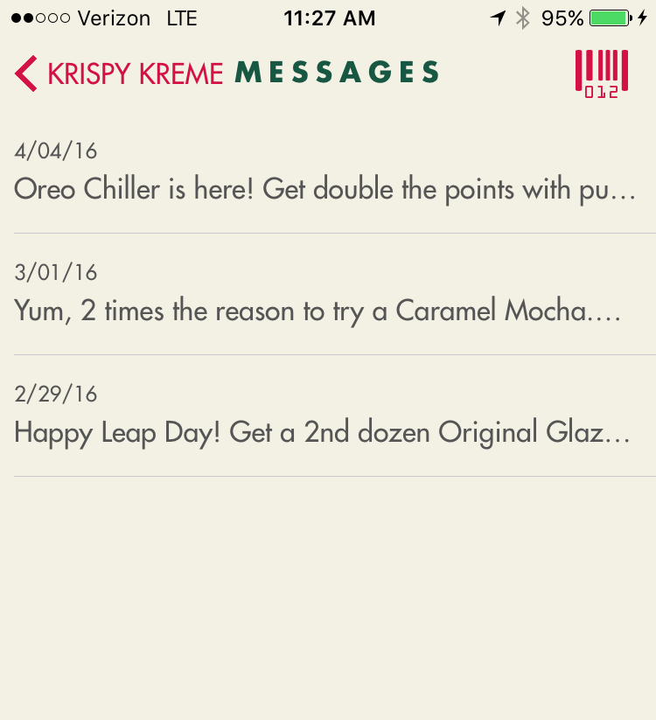
The Main Page:
Messages
The callout bubble above the Stored Value box indicates the number of unread messages in the members inbox
Types of messages include:
Birthday Treats
Exclusive Offers
New Product News
Messages

Slide 18
The Main Page:
Bar Code
By pressing the bar code button, the member will be able to scan their app to receive rewards points
The guest can also press the bar code button to use the mobile pay function as well
Bar code

Slide 19
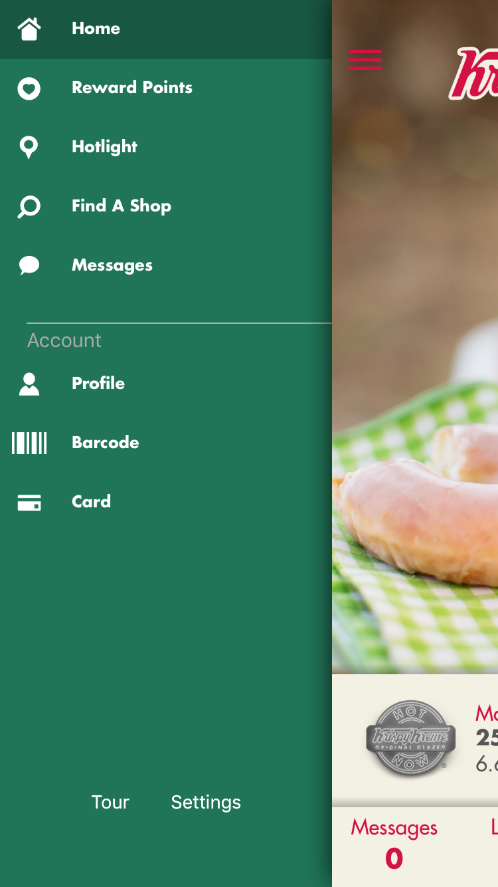
The Main Page:
Menu screen
Menu
The Menu Screen allows access to:
Messages
Stored Value functionality
Gift Functionality
Member Profile Information
Order History
App Help
The Menu Screen Button is available on every screen within the app!

