Slide 1
Krispy
Kreme
Rewards
Part II

Slide 2
Part III:
Engaging the Guest

Slide 3
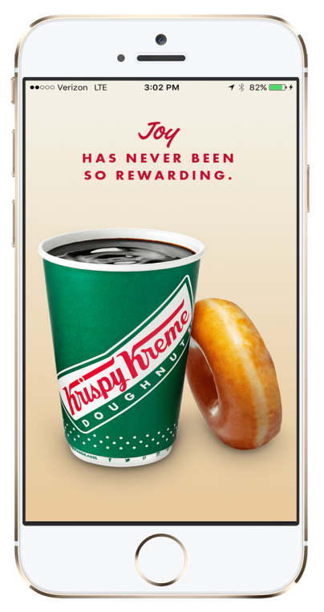
Engaging the Guest
Our team members are tasked with ENTICING our guests to become rewards members
This is done through ENGAGEMENT at every point of the Krispy Kreme experience

Slide 4
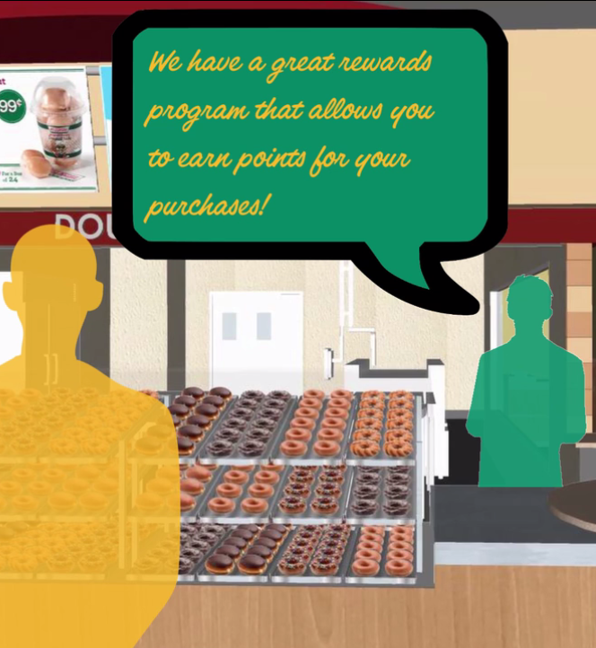
Engaging the Guest:
Starting the Discussion
If the guest is not a rewards member, they have the opportunity to ENTICE the guest by briefly informing them of the benefits…
“If you join, you can earn 5 points for every dollar spent at Krispy Kreme.”
“You will receive a free doughnut of your choice just for becoming a member!”

Slide 5
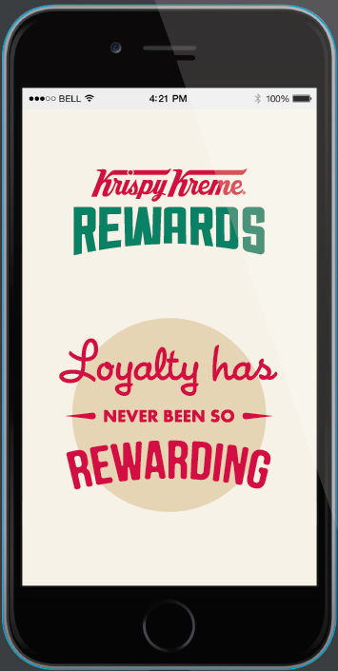
Engaging the Guest:
At the Register
If the team member did not have a chance at the front door, they can ask the guest…
Back
Front
“May I scan your app to apply your points for this purchase?”
… Or, if the guest is not a member, provide the guest with our Loyalty Handouts ...
“If you are not familiar with our Rewards program, here are multiple ways to download the app to start earning points.”
Available through MIX

Slide 6
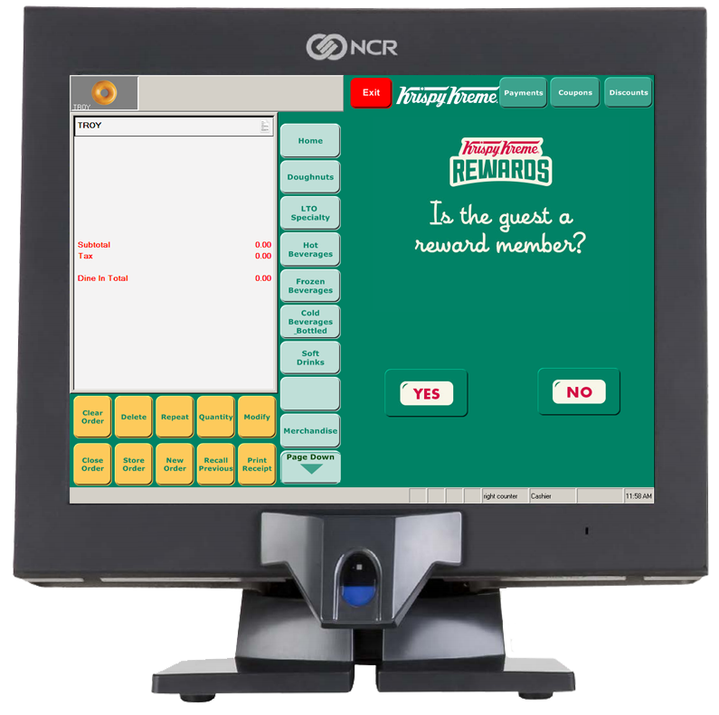
Engaging the Guest:
At the Register
Finally, when the team member is closing the order, ask the guest if they are a rewards member when you see the rewards button on the register screen.

Slide 7
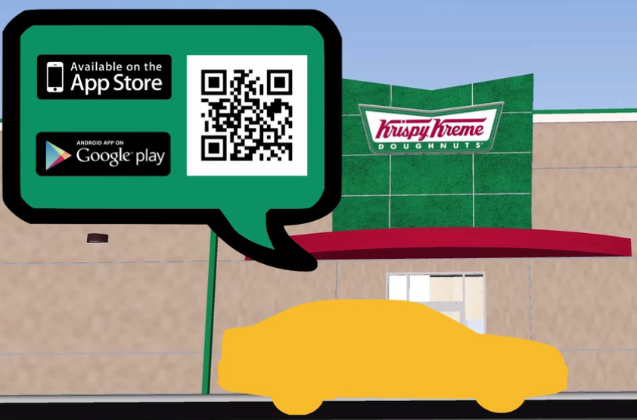
Engaging the Guest:
At the Drive Thru
The Drive Thru deserves the same attention as the lobby…
“May I scan your app to apply your points for this purchase?”
“If you have not had a chance to download the app, go to krispykremerewards.com to start earning points.”

Slide 8
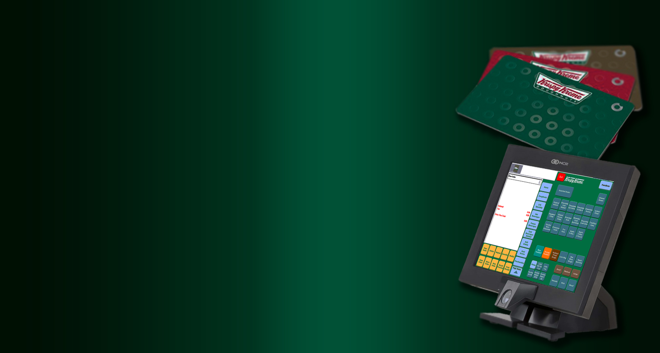
Part IV:
Stored Value and Register Functions

Slide 9
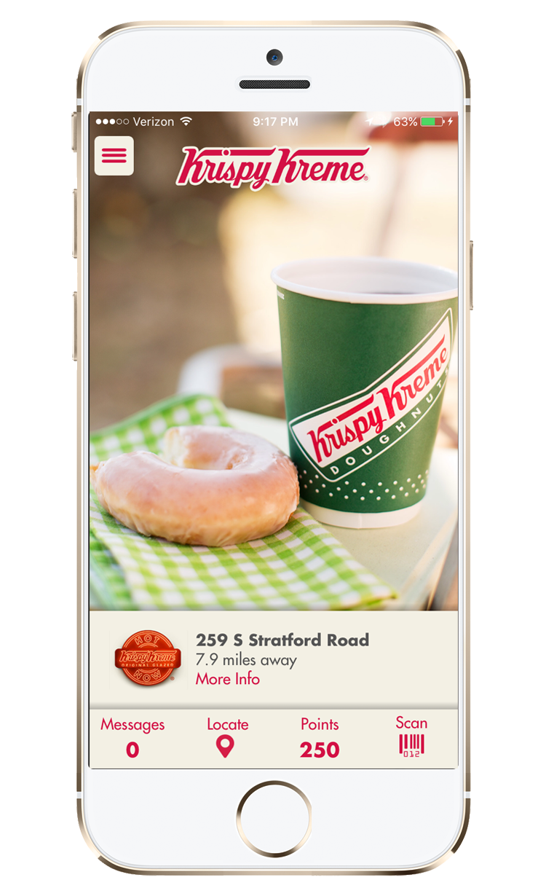
Stored Value:
Options of Use
The Stored Value Function provides members an opportunity to:
Pay with pre-loaded dollars from their credit card
Use Stored Value Dollars

Slide 10
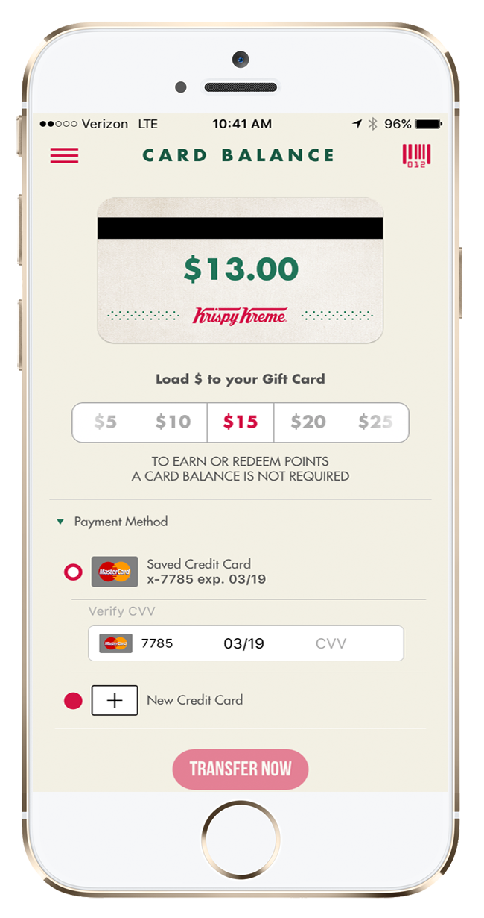
Stored Value:
Loading Dollars
The member can load dollars from a credit card in $5 increments
These dollars can be used for any purchase in the store
This page is accessed by going through the menu screen
Account Balance

Slide 11
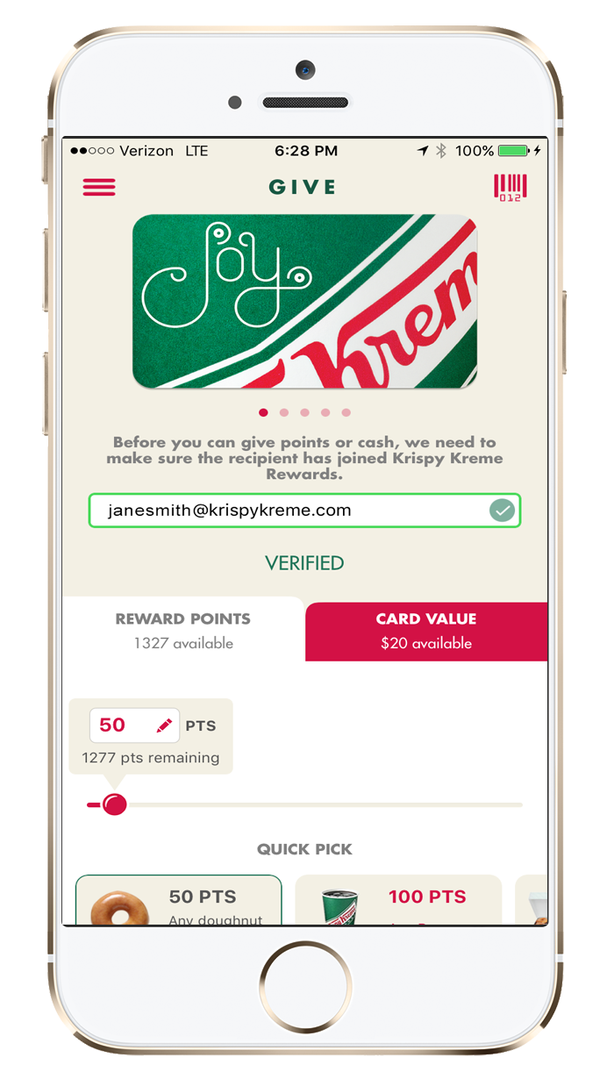
The give function allows rewards members to share the joy of Krispy Kreme with other members
This page is accessed through the menu screen
The member decides how much to give
You can
only give stored value to other members
Stored Value:
Give Function

Slide 12
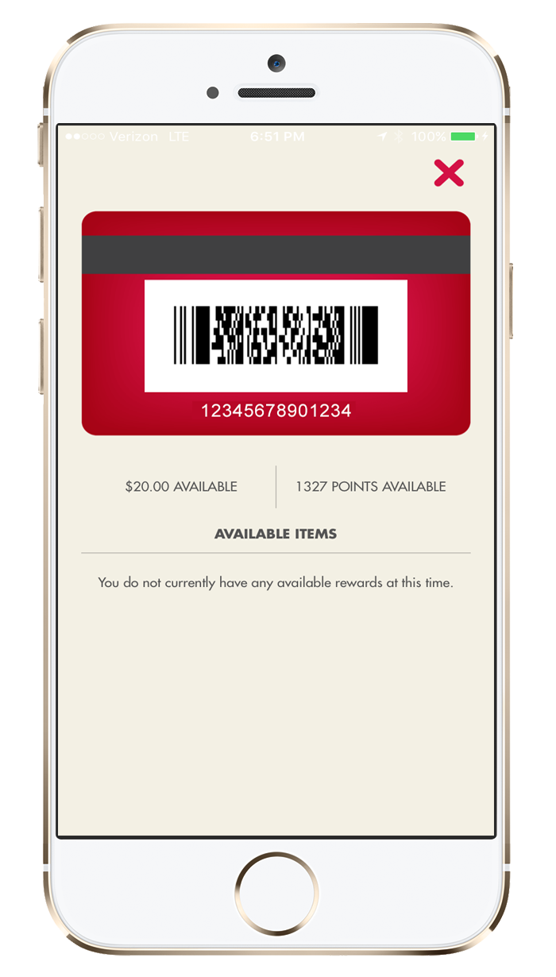
Stored Value:
Processing Payments
Processing Stored Value Payments is Easy
Have the member press the barcode button
Press Close Order
Press Mobile Pay
Press Ok
Scan the barcode
If the guest has a balance after they use Stored Value Dollars, close out the payment as you normally would
From the Home Screen
All other menu screens

Slide 13
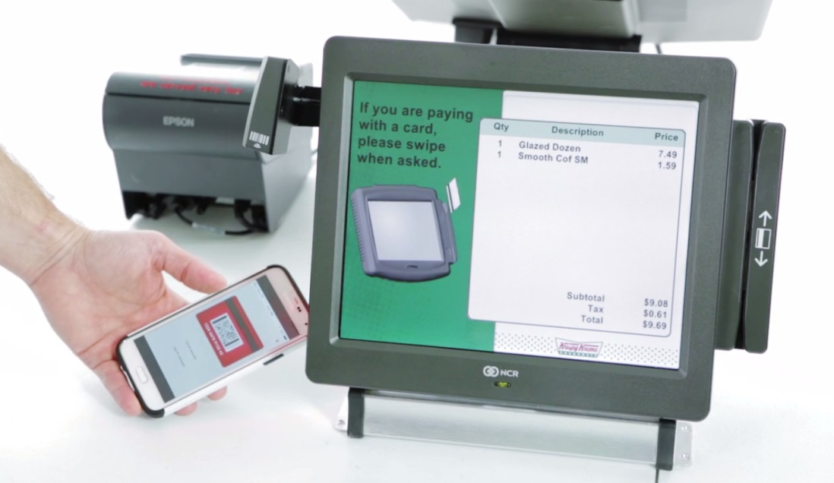
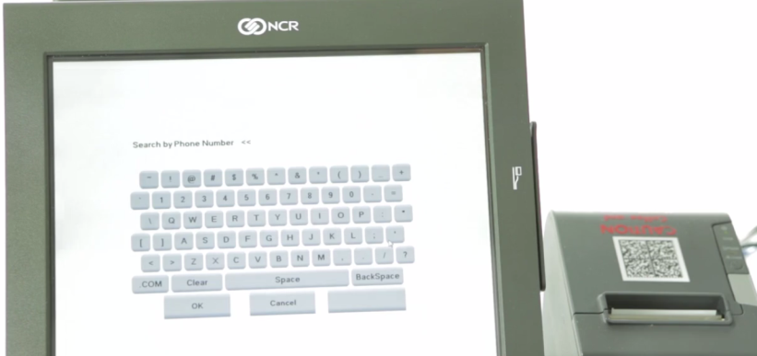
Adding Rewards Points:
Have the member press the barcode button
Press Close Order
Press Krispy Kreme Rewards
Scan the barcode
Press Ok
REMEMBER! If the guest does not have their App open, you may enter their phone number to add points to their account!
Earning Points:
Processing

Slide 14
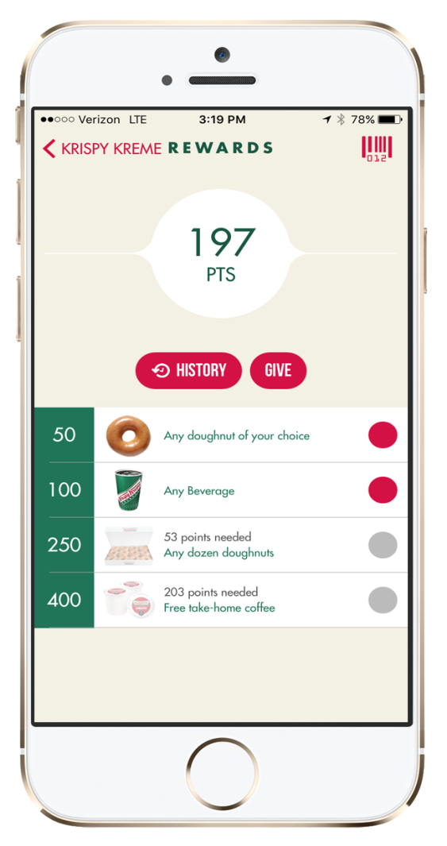
Redeeming Points:
At the register.
Redeeming Points:
The member must select the reward first
Press Close Order
Press Krispy Kreme Rewards
Scan the barcode
Press Ok
THE REWARD WILL BE
AUTOMATICALLY DEDUCTED!
If there is a balance, then process the payment as you normally would
Earned Rewards
Future Rewards

Slide 15
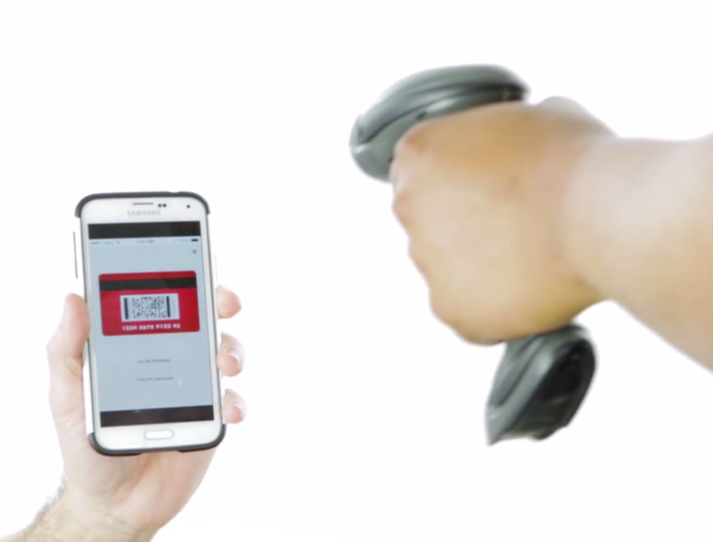
Redeeming Points:
At the Drive Thru
Drive Thru functions are the same
REMEMBER! Do not take the member’s phone for any reason
Use the scanner from the Drive Thru register
If you cannot reach or the guest does not have the app open, ask for their phone number

Slide 16
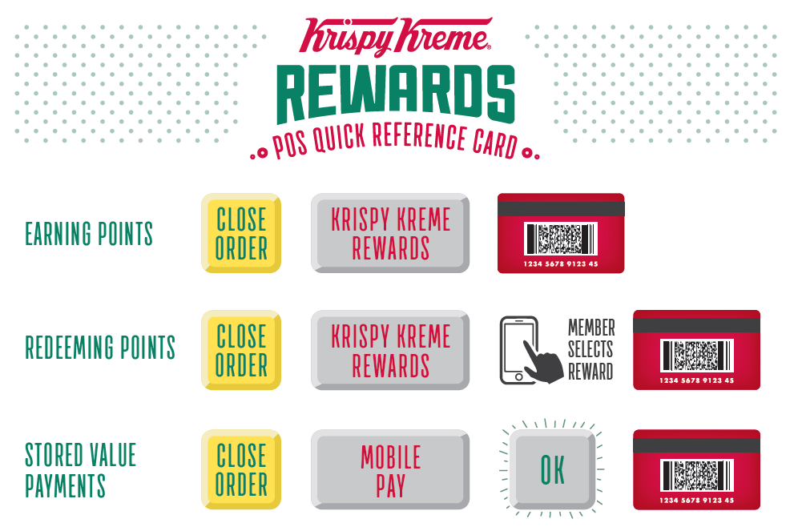
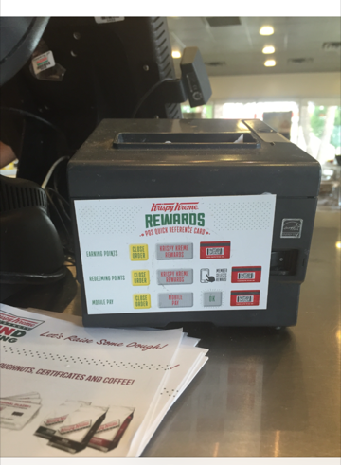
Available through Shay Wilson
POS Reference

Slide 17
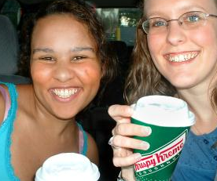
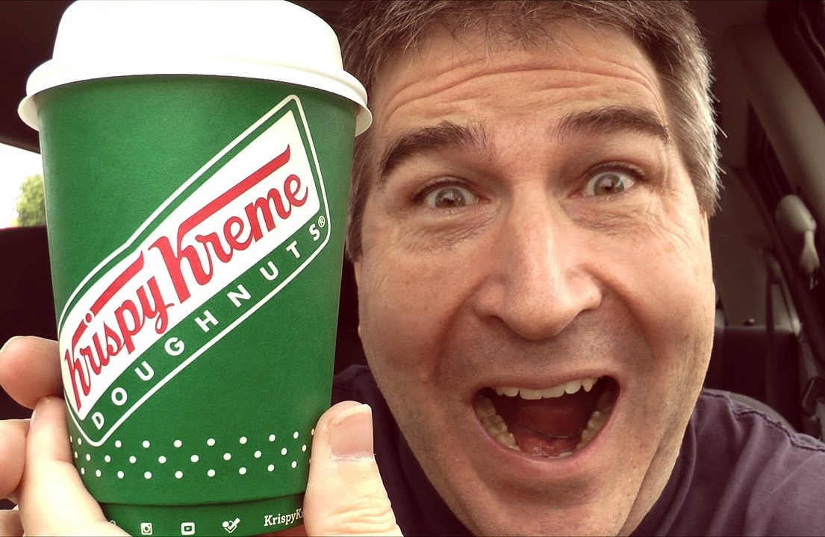
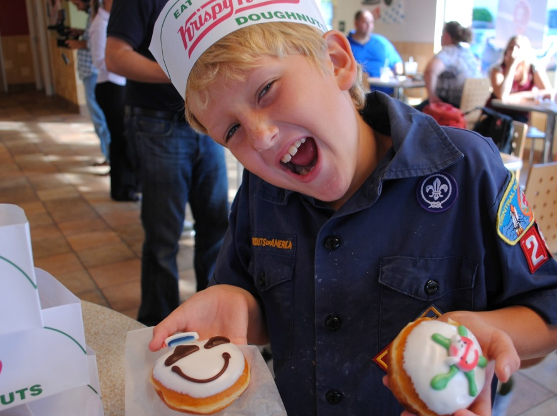
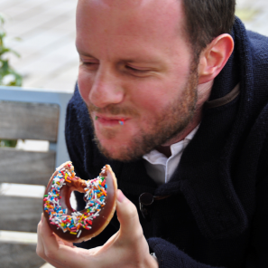
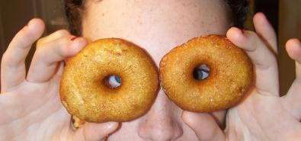
J Y
THE ESSENCE OF OUR BRAND
Notes:
Speak to “touching and enhancing lives through the joy”

Slide 18
Hands on
Exercise

